Slide 1
Acquire Valued Shoppers
Supervisor : Dr. Dinesh Gopalani
Honey Duhar (2012ucp1531)
Hemant Kumar Meena (2012ucp1160)
Pavan Mahawar (2012ucp1211)

Slide 2
Index
Problem statement
Motivation
Technique
Dataset
Algorithms used
Decision Tree
Bagging Trees
Random Forest
Naïve Bayes
Papers referred

Slide 3
Problem Statement
Consumer brands often offer discounts to attract new shoppers to buy their products or to retain the existing customer. The most valuable customers are those who return after this initial incentive purchase.
So our task is to provide a prediction model to predict which shoppers are most likely to repeat purchase. So basically our problem statement is Customer Churn Prediction.

Slide 4
Motivation
Used a lot by companies as the cost of retaining a customer is far less than making a new customer.
Maximum AUC achieved during the Kaggle competition was 0.62773
A lot of chance to improve the classifier, provided we are able to engineer the required features.

Slide 5
Technique
The basis for any technique is historical data containing information about past churners. A comparison is made between these churners and existing customers. Likely churners are identiﬁed as customers for which the classiﬁcation suggests similarity to prior churners.
We will be using different algorithm for the construction of a classification model, mainly supervised machine learning, boosting and feature engineering.

Slide 6
Dataset
To create the prediction, a minimum of a year of shopping history prior to each customer's incentive, as well as the purchase histories of many other shoppers is provided.
The transaction history contains all items purchased, not just items related to the offer.
This data captures the process of offering incentives to a large number of customers and forecasting those who will become loyal to the product.

Slide 7
Files :
We are provided with four relational files:
transactions.csv - contains transaction history for all customers for a period of at least 1 year prior to their offered incentive.
trainHistory.csv - contains the incentive offered to each customer and information about the behavioral response to the offer.
testHistory.csv - contains the incentive offered to each customer but does not include their response (we need predict the repeater column for each id in this file.
offers.csv - contains information about the offers.

Slide 8
Fields
Data Files | Properties
Past Transactions | Customer ID, store, product department, product company, product category, product brand, date of purchase, product size, product size, product measure, purchase quantity, purchaseAmount
Training History | Customer ID, store, offer ID, geographical region, number of repeat trips, repeater, offer date
Testing History | Customer ID, store, offer ID, geographical region, number of repeat trips, repeater, offer date
Offers | Offer ID, offer category, offerquantity, offer company, offer value, offer brand

Slide 9
Algorithms Used
In our classification problem we are using –
Decision Tree Classification
Bagging Tree
Random Forest Classification
Naive Bayes Classification

Slide 10
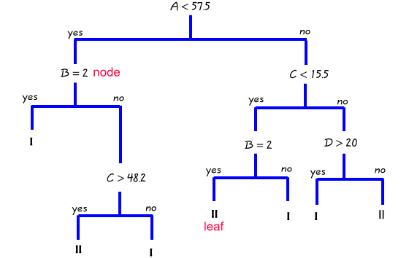
Decision Tree
Commonly used machine learning approach for classification and regression.
It creates a hypothesis tree providing classification probabilities in the leaf nodes.

Slide 11
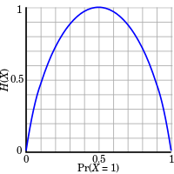

Splitting Criteria: Entropy
Entropy is a measure of unpredictability of information content.
$$Entropy\left(s\right)=−Σplog2p$$
Notes:
Check formula pilogpi

Slide 12

A split variable is selected which has maximum information gain.
$$Information gain=Entropy\left(parent\right)−Expected entropy(children)$$
p +ve prob.
n –ve prob
M samples
s = - p*logp - n*logn
E[s] = (m1/m)(s)
E[s] = (m2/m)(s)
P’ +ve prob.
n’ –ve prob.
m1 samples
P’’ +ve prob
n’’ –ve prob
m2 samples

Slide 13
Split for continuous variables :
Sort data according to that variable.
Calculate information gain only when there is a change in class.
Split for discrete variables:
Data is split for available discrete values.

Slide 14
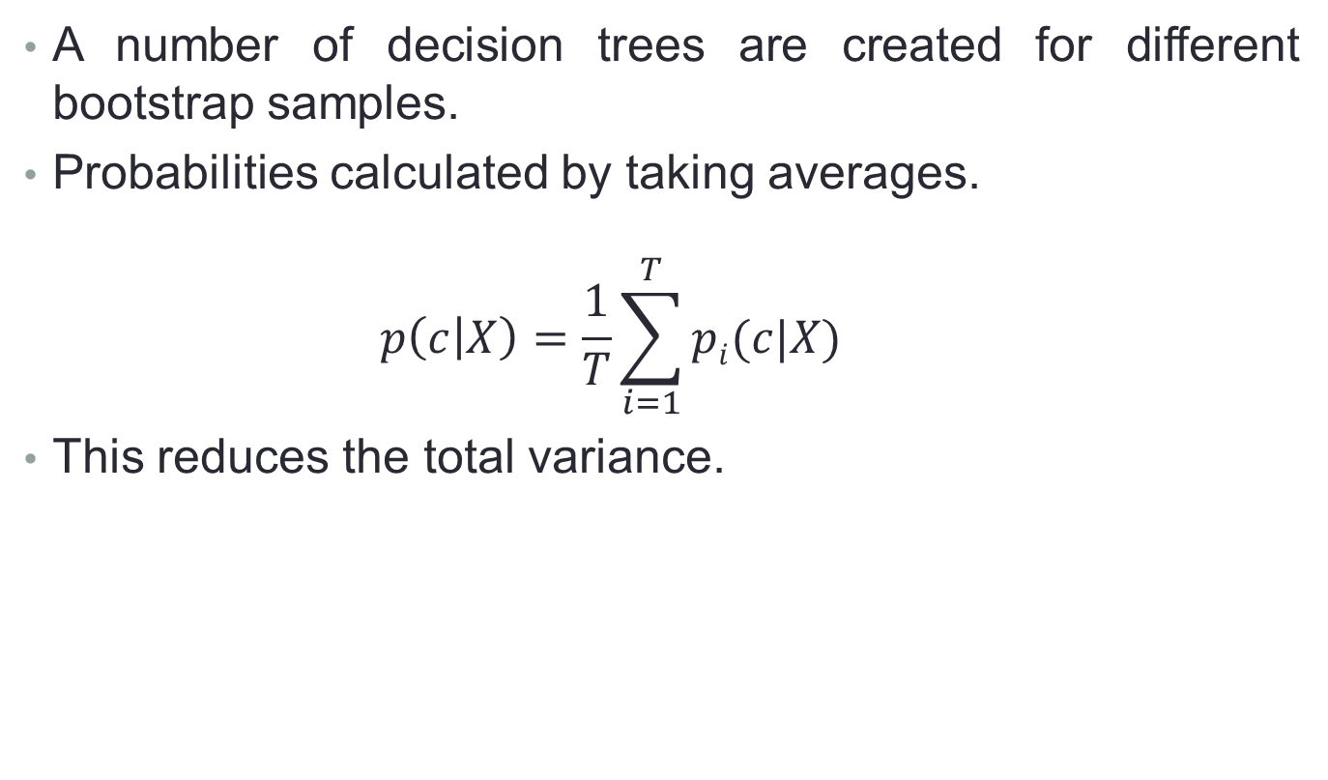
Bagging Trees
A number of decision trees are created for different bootstrap samples.
Probabilities calculated by taking averages.
$$p\left(c | X\right)=\frac{1}{T}\sum_{i=1}^{T}{pi(c|X) }$$
This reduces the total variance.

Slide 15
Random Forest Classification
Random forest (or random forests) is an ensemble classifier that consists of many decision trees and outputs the class that is the mode of the class's output by individual trees.
Decision trees are individual learners that are combined. They are one of the most popular learning methods commonly used for data exploration.

Slide 16
Random Forest: More randomness
A number of decision trees created similar to bagging trees by bootstrapping samples.
While selecting the best split variable the algorithm is given with comparatively less number of variables to choose from.
Further reduces the variance by introducing more randomness while variable selection.

Slide 17
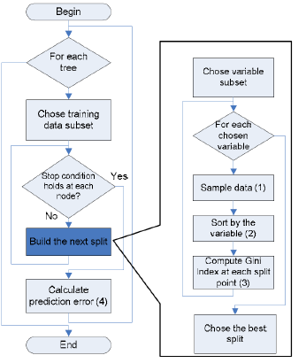
Flow Chat For Random Forest

Slide 18
Naive Bayes Classification
Naive Bayes is a simple technique for constructing classifiers: models that assign class labels to problem instances
Naive Bayes Classification
Algorithm: Discrete-Valued Features
Algorithm: Continuous-valued Features

Slide 19
Algorithm: Discrete-Valued Features
Learning Phase: Given a training set S
Output: conditional probability tables

Slide 20
Test Phase: Given an unknown instance ,
Look up tables to assign the label c* to X’ if
Label = max( P(c1),P(c2)……P(cn) )

Slide 21
Algorithm: Continuous-valued Features
Conditional probability often modeled with the normal distribution
Learning Phase:
Output: normal distributions and
Test Phase: Given an unknown instance
Instead of looking-up tables, calculate conditional probabilities with all the normal distributions achieved in the learning phrase

Slide 22
Results
AUC Achieved for different algorithms

Slide 23
Algorithm | sample_size | num_trees | height | AUC
Naïve Bayes | - | - | - | 0.50000
Decision Tree | - | 1 | 15 | 0.53758
Bagging Trees | complete-datasize | 600 | 15 | 0.55493
Random Forests | complete-datasize | 600 | 15 | 0.56246
25% +ves Random Forest | complete-datasize | 600 | 15 | 0.57313

Slide 24
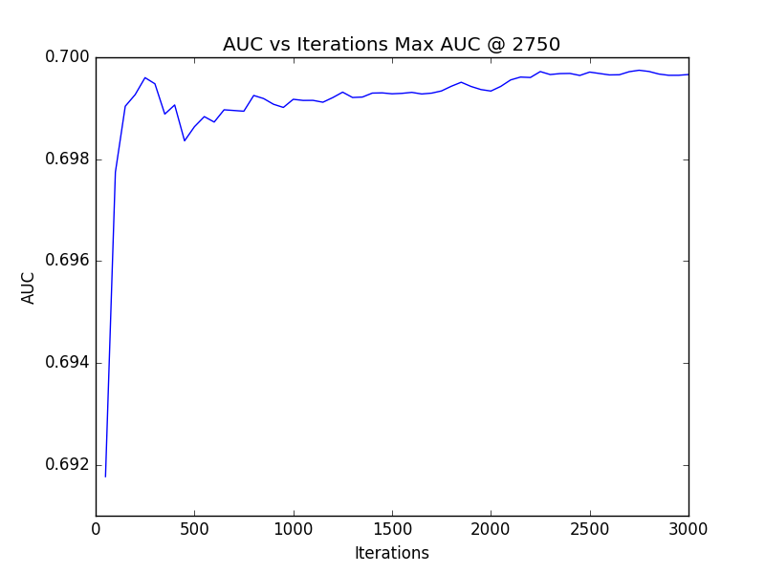
AUC vs Number of trees plot for random forest

Slide 25
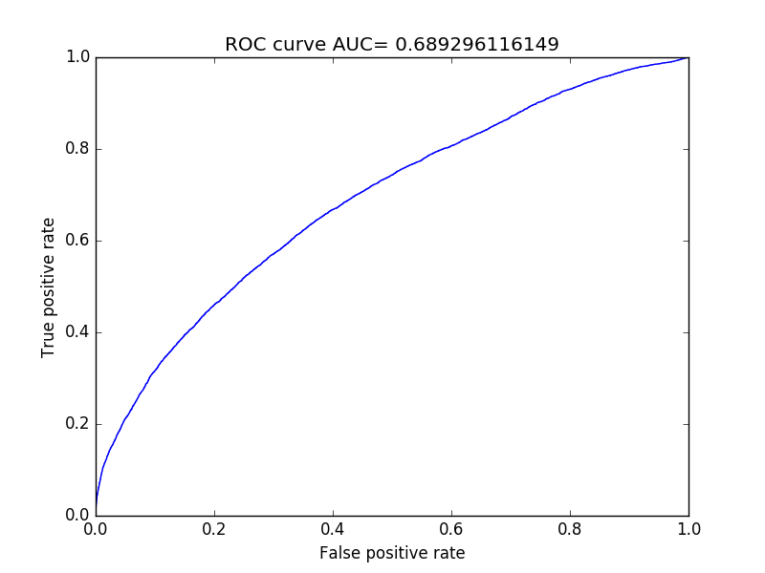
ROC Curve for 600 random trees

Slide 26
References
V. Nikulin, “On the Method for Data Streams Aggregation to Predict Shoppers Loyalty” in 2015 International Joint Conference on Neural Networks (IJCNN) pp.1-8, 12-17 July 2015, Killarney.
Y. Xie, X. Li, E.W.T. Ngai, W. Ying, “Customer Churn Prediction using Improved Balanced Random Forests” in Expert Systems with Applications: An International Journal Volume 36 Issue 3, pp. 5445-5449, April 2009.
M.Mehta, R. Agrawal, J. Rissanen, “SLIQ: A fast scalable classifier for data mining” in Advances in Database Technology — EDBT '96 Volume 1057 of the series Lecture Notes in Computer Science pp.18-32, June 10, 2005.
W. Loh, Y. Shih, “Split Selection Methods for Classification Trees” in Statistica Sinica pp. 815-840, 1997.
L.Breiman, “Bagging Predictors” in Machine Learning, Volume 24, Issue 2, pp 123-140, August 1996.
Leo Breiman, “Random forest” in machine Learning, Volume 45, Issue 1, pp5-32. Oct. 2001.
J. Li, J. Lim “Using Decision Tree to Predict Repeat Customer”.[Online]. Available: http://cs229.stanford.edu/proj2015/035_report.pdf. [Accessed: Jan. 15, 2016].
“Acquire Valued Shoppers Challenge” kaggle.com, April 10,2014 .[Online]. Available: www.kaggle.com/c/acquire-valued-shoppers-challenge. [Accessed: Jan. 20, 2016].

Slide 27


